Slide 1
MENTAL HEALTH COMPANION
Presentation by TEAM: SCRIET
July - 2025

Slide 2
Agenda
Key Features
Daily Mood Check-ins
AI-driven Self-Care Suggestions (e.g., breathing exercises, journaling prompts)
Anonymous Peer Support
Habit Gamification (badges, streaks)
Wearable Device Integration
Introduction
Background on mental health trends
Importance of accessible support for youth
Impact & Benefits:
Encourage postive habits
Builds mental health awareness
Problem Statement
Rising stress and anxiety
Barriers to traditional mental health care
Technology Stack
Frontend: Flutter (for cross-platform mobile app)
Backend: Firebase (Auth, Firestore, Analytics)
AI Module: Python (for recommendation engine)
API: REST or GraphQL
Objective
Build a digital companion that promotes mental wellbeing through simplicity, privacy, and personalization
Proposed Solution: MindMate App
Overview of the app
Target audience

Slide 3
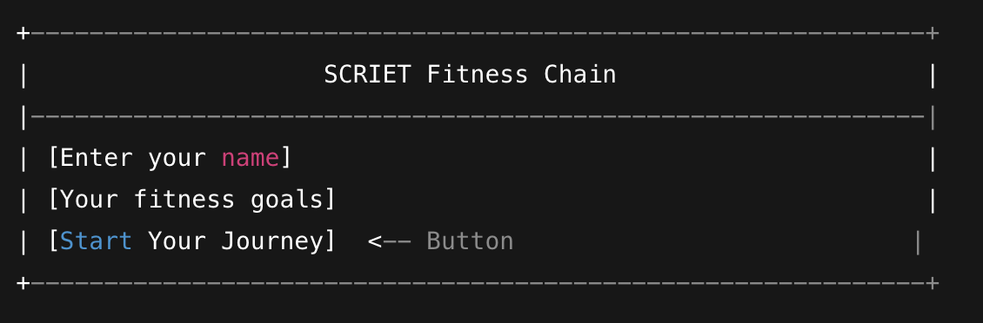
Project Overview
Purpose
The purpose of this project is to develop a simple, private, and accessible digital solution that empowers individuals—especially youth—to manage their mental health effectively. By enabling users to track their mood, reduce stress, and adopt healthy self-care routines through AI-driven suggestions and anonymous peer support, the app aims to promote positive behavioral change and make mental wellness support more approachable and consistent in everyday life.
This solution focuses on:
Encouraging daily emotional awareness
Delivering personalized mental wellness tips
Creating a safe and anonymous space for peer interaction
Using technology (AI & wearables) to make self-care engaging and intelligent
Ensuring user privacy and simplicity throughout the experience

Slide 4
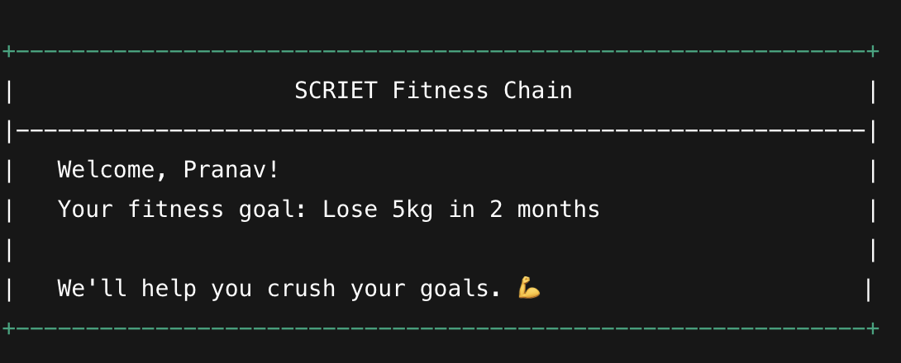
Web App Demo & Screenshot
Functionality
Start Strong. Stay Committed. Succeed with SCRIET.”
“Your fitness, your goals, your name — personalized.”
“Fuel your journey with purpose and progress.”
“Where college minds build stronger bodies.”
“Track it. Own it. Achieve it.”
“Your journey begins with one click"
App Interface
The app showcases an intuitive interface that is visually appealing and easy to navigate, prioritizing user engagement with its design.

Slide 5

User Activities & Benefits
Benefits
Engagement
Boosts motivation by personalizing the fitness experience for every user."
"Encourages consistency with goal-oriented tracking."
"Easy to use — ideal for beginners, students, or anyone starting their fitness journey."
"Visually inspiring design powered by motivati
"Helps users stay committed with a simple, focused interface that celebrates progress."
User enters their name and fitness goal – this is interaction.
User clicks “Start Your Journey” – this is action and intent.
User returns later to update or track progress – this is retention and continued engagement.
Activities
Users begin by entering their name and fitness goals, creating a personalized journey right from the start."
"The web app encourages daily goal tracking and reinforces consistency through simple, engaging interactions."
"Each user receives a custom welcome message, keeping motivation high and progress visible."

Slide 6
Data & Impact
our app collects basic but meaningful personal data:
User Name – helps personalize the experience.
Fitness Goals – tracks user intent and focus.
USER ACTIVITIES | MANY LOGS
Improvements | reported better mood
Feedback | Most would recommend it

